Slide 1
An Unsupervised Feature Selection algorithm based on Ant Colony Optimization
Aaron Estrada Poggio

Slide 2
Article information
Tabakhi, S., Moradi, P., & Akhlaghian, F. (2014). An unsupervised feature selection algorithm based on ant colony optimization. Engineering Applications of Artificial Intelligence, 32, 112-123.
https://www.researchgate.net/publication/261371258_An_unsupervised_feature_selection_algorithm_based_on_ant_colony_optimization

Slide 3
If you torture the data long enough, it will confess.
Ronald Coase

Slide 4
Data Mining
The computational process to find knowledge from datasets, which is expressed using a comprehensible structure.

Slide 5
Data Mining – some tasks and applications
Supervised learning
Class labels associated
Unsupervised learning
Classification
Applications
Text categorization
Face recognition
Cancer classification
Finance
Clustering
No labels associated
Notes:
a) Supervised learning: Labels are used to guide the search process for relevant information.
b) Unsupervised learning: No class labels associated. It is more difficult to find relevant information.

Slide 6
Data Mining – Curse of Dimensionality (1)
Number of features larger than number of patterns
Performance reduced
Computational complexity increased

Slide 7
Data Mining – Curse of Dimensionality (2)
Feature Selection
Remove irrelevant and redundant features.

Slide 8
1.000
2^{1.000}
features
different feature subsets!
Feature Selection
Remove irrelevant and redundant features.
Find a near-optimal feature subset in a reasonable time.

Slide 9
Data Mining - Feature Selection – Approaches
Filter approach
Feature relevance relies on statistic data
Independent from learning algorithms
Univariate
Feature dependency ignored
Information gain
Gain ratio
Fisher score
Multivariate
Feature dependency considered
Mutual correlation
Minimal-redundancy-maximal-relevance (MRMR)
Random subspace methods (RSM)

Slide 10
Data Mining - Feature Selection – Approaches
Wrapper approach
Uses a learning algorithm to select features
Sequential search
Add or remove features sequentially. Tendency to become trapped into a local optimum.
Sequential backward selection
Sequential forward selection
Floating search method
Random search
Embed randomness to escape local optimum solutions
Random mutation hill-climbing
Genetic algorithms
Ant Colony Optimization (ACO)

Slide 11
Data Mining - Feature Selection – Approaches
Embedded approach
Search of good subset of features performed by learning algorithm
A
B
Decision Trees
Naïve Bayes
Support Vector Machine (SVM)

Slide 12
Data Mining - Feature Selection – Approaches
Hybrid approach
Filter approach
Wrapper approach
Feature set
Reduced
feature subset
Final
feature subset
ACO + mutual information
ACO + chi-square with SVM
Mutual information + genetic algorithms
Mutual information + Swarm optimization with SVM

Slide 13
Feature Selection – Approaches
Computational time
performance
VS
Quality of
selected features
Filter
Wrapper
Embedded
Hybrid
Trade-off
How to deal with the trade-off?

Slide 14
Unsupervised Feature Selection algorithm based on Ant Colony Optimization (UFSACO)
Unsupervised learning
Does not need class labels
“Filter approach”
Acceptable computational time and no learning algorithm needed
Based on ACO
High quality approximation of the solution and efficient for high-dimensional datasets
Minimize redundancy
Reached through feature similarity heuristics.

Slide 15
Ant Colony Optimization (ACO)
Based on the social behavior of ants while seeking food
Cooperative work of ants to solve hard combinational optimization problems
3. Ant chooses shortest path
1. Ant leaves pheromone
2. Pheromone decrease intensity
Notes:
* Ants perform simple tasks
* Cooperative work of the colony provides models for solving hard combinational optimization problems
* Communication through chemical substance (pheromone) deposited on the ground where they walk
* Pheromone evaporates over time -> decrease its intensity
* Ants prefer choosing paths with more pheromones, selecting shortest path to get food and return faster to the nest than other ants

Slide 16
Ant Colony Optimization (ACO) - Strengths
Multi-agent system
Ants cooperate by sharing knowledge through pheromone trail to solve the problem efficiently
Parallel implementation
Distribution allows a decrease in computational time
Distributed long-term memory
Memory used to store knowledge obtained from ants in previous searches
Global and local search capabilities
Exploitation - strong local search ability
Exploration - avoid being trapped in local minimum

Slide 17
UFSACO – Components
Graph representation for searching
Heuristic desirability
Working cycle
Pheromone update
Feature selection

Slide 18
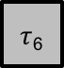

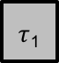
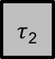
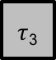
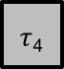
UFSACO – Graph representation for searching
Searching space as undirected graph
Edges
Similarity between features
$τ$₁
$τ$₂
F₁
F₂
$τ$₃
$τ$₄
F₃
F₄
Nodes
Each feature is represented as a node
F₅
F₆
Pheromone
Stored in a feature, not in edge.
$τ$₅
$τ$₆

Slide 19
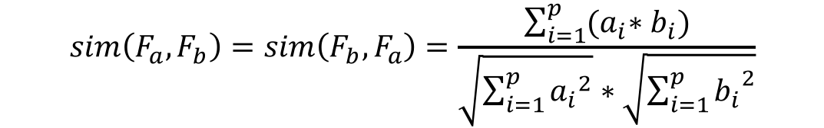
UFSACO – Graph representation for searching
Cosine similarity between features
$$sim\left(F_{a}, F_{b}\right)=sim\left(F_{b}, F_{a}\right)=\frac{\sum_{i=1}^{p}{{(a}_{i}∗b_{i})}}{\sqrt{\sum_{i=1}^{p}{{a_{i}}^{2}}}∗\sqrt{\sum_{i=1}^{p}{{b_{i}}^{2}}}}$$
F_{a}, F_{b} Feature a/b
p Total of patterns in dataset
a_{i}, b_{i} Value of feature a/b for pattern_{i}

Slide 20
UFSACO – Components
Graph representation for searching
Heuristic desirability
Working cycle
Pheromone update
Feature selection

Slide 21
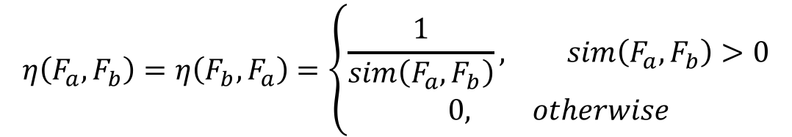
UFSACO – Heuristic desirability
Heuristic information
$$η\left(F_{a}, F_{b}\right)=η\left(F_{b}, F_{a}\right)=\left\{\begin{aligned}\frac{1}{sim\left(F_{a}, F_{b}\right)}, sim\left(F_{a}, F_{b}\right)>0 \\ &0, otherwise\end{aligned}\right.$$

Slide 22
UFSACO – Heuristic desirability
Desirability of movement
An ant seeks to select features based on:
Highest pheromone values
Lowest similarities to previous selected features (heuristic information)
Pseudo-random-proportional rule: transition rule based on random value q

Slide 23
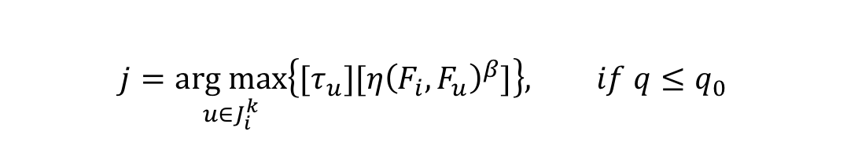
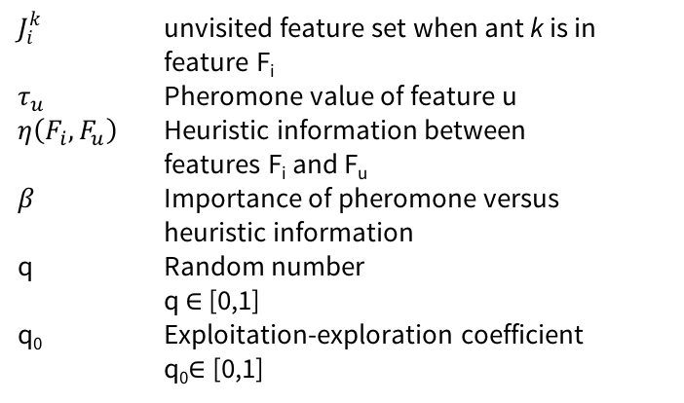
UFSACO – Heuristic desirability Pseudo-random-proportional rule
Exploitation – Greedy transition rule
$$j=\underset{u∈J_{i}^{k}}{arg max}\left\{{[τ}_{u}][{η\left(F_{i}, F_{u}\right)}^{β}]\right\}, if q≤q_{0}$$
$J_{i}^{k}$ unvisited feature set when ant k is in
feature F_{i}
$τ_{u}$ Pheromone value of feature u
$η\left(F_{i}, F_{u}\right)$ Heuristic information between features F_{i} and F_{u}
$β$ Importance of pheromone versus heuristic information
q Random number
q $∈$ [0,1]
q₀ Exploitation-exploration coefficient
q₀$∈$ [0,1]

Slide 24
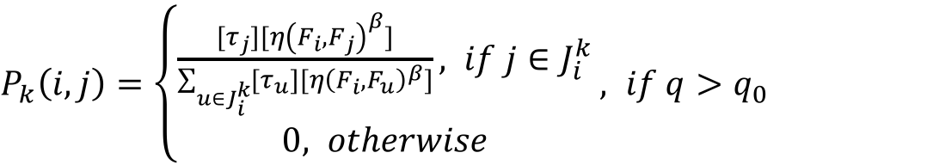
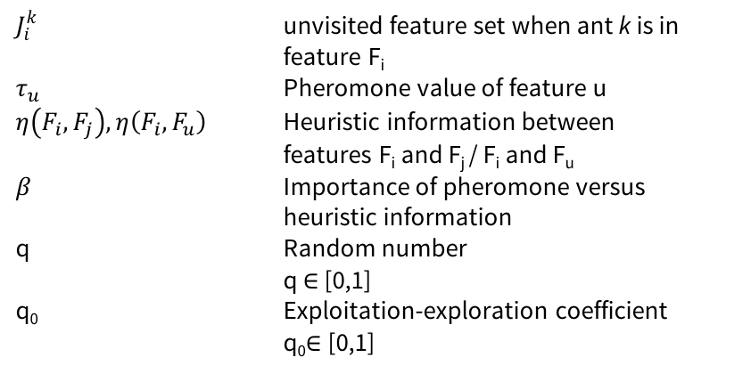
UFSACO – Heuristic desirability Pseudo-random-proportional rule
Exploration – Probabilistic transition rule
$P_{k}\left(i,j\right)=\left\{\begin{aligned}\frac{{[τ}_{j}][{η\left(F_{i}, F_{j}\right)}^{β}]}{\sum_{u∈J_{i}^{k}}{{[τ}_{u}][{η\left(F_{i}, F_{u}\right)}^{β}]}}, if j∈J_{i}^{k} \\ &0, otherwise\end{aligned}\right.$ $, if q>q_{0}$
$J_{i}^{k}$ unvisited feature set when ant k is in
feature F_{i}
$τ_{u}$ Pheromone value of feature u
$η\left(F_{i}, F_{j}\right), η\left(F_{i}, F_{u}\right)$ Heuristic information between features F_{i} and F_{j} / F_{i} and F_{u}
$β$ Importance of pheromone versus heuristic information
q Random number
q $∈$ [0,1]
q₀ Exploitation-exploration coefficient
q₀$∈$ [0,1]

Slide 25
UFSACO – Components
Graph representation for searching
Heuristic desirability
Working cycle
Pheromone update
Feature selection

Slide 26
UFSACO – Working cycle
Long-term distributed memory
Initialize global feature counter (FC)
N_{ants} ants placed in random features
Each ant seeks NF different features
q random value is calculated on each ant movement
Notes:
Pseudo-random-proportional rule
Long-term distributed memory: A global visited feature counter is used

Slide 27
UFSACO – Working cycle Example
Ant 1 visiting N_{ant}=3 features
Feature Counter (FC)
Placed randomly in F₁
F₁
F₂
Feature | Visits
F₁ | 0
F₂ | 0
F₃ | 0
F₄ | 0
F₅ | 0
F₆ | 0
F₃
F₄
F₅
F₆

Slide 28
UFSACO – Working cycle Example
Ant 1 visiting N_{ant}=3 features
Feature Counter (FC)
F₁
F₂
Feature | Visits
F₁ | 0
F₂ | 1
F₃ | 0
F₄ | 0
F₅ | 0
F₆ | 0
F₃
F₄
F₅
F₆

Slide 29
UFSACO – Working cycle Example
Ant 1 visiting N_{ant}=3 features
Feature Counter (FC)
F₁
F₂
Feature | Visits
F₁ | 0
F₂ | 1
F₃ | 1
F₄ | 0
F₅ | 0
F₆ | 0
F₃
F₄
F₅
F₆

Slide 30
UFSACO – Working cycle Example
Ant 1 visiting N_{ant}=3 features
Feature Counter (FC)
F₁
F₂
Feature | Visits
F₁ | 0
F₂ | 1
F₃ | 1
F₄ | 1
F₅ | 0
F₆ | 0
F₃
F₄
F₅
F₆

Slide 31
UFSACO – Working cycle Example
Ant 2 visiting N_{ant}=3 features
Feature Counter (FC)
F₁
F₂
Feature | Visits
F₁ | 0
F₂ | 1
F₃ | 1
F₄ | 1
F₅ | 0
F₆ | 0
F₃
F₄
Placed randomly in F₅
F₅
F₆

Slide 32
UFSACO – Working cycle Example
Ant 2 visiting N_{ant}=3 features
Feature Counter (FC)
F₁
F₂
Feature | Visits
F₁ | 0
F₂ | 2
F₃ | 1
F₄ | 1
F₅ | 0
F₆ | 0
F₃
F₄
F₅
F₆

Slide 33
UFSACO – Working cycle Example
Ant 2 visiting N_{ant}=3 features
Feature Counter (FC)
F₁
F₂
Feature | Visits
F₁ | 0
F₂ | 2
F₃ | 1
F₄ | 1
F₅ | 0
F₆ | 1
F₃
F₄
F₅
F₆

Slide 34
UFSACO – Working cycle Example
Ant 2 visiting N_{ant}=3 features
Feature Counter (FC)
F₁
F₂
Feature | Visits
F₁ | 0
F₂ | 2
F₃ | 1
F₄ | 2
F₅ | 0
F₆ | 1
F₃
F₄
F₅
F₆

Slide 35
UFSACO – Components
Graph representation for searching
Heuristic desirability
Working cycle
Pheromone update
Feature selection

Slide 36
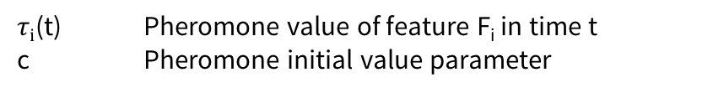
UFSACO – Pheromone update
Initial pheromone value
All features start with same pheromone value
$$τ_{i}\left(t=0\right)=c$$
$τi$(t) Pheromone value of feature F_{i} in time t
c Pheromone initial value parameter

Slide 37

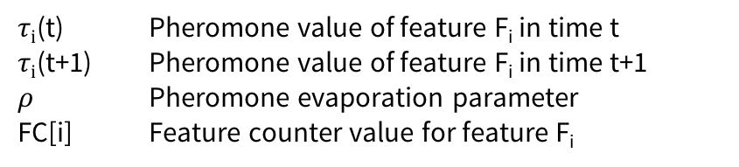
UFSACO – Pheromone update
Global updating rule
Applied to all nodes after each ants’ working cycle.
$$τ_{i}\left(t+1\right)=\left(1−ρ\right){∗τ}_{i}\left(t\right)+\frac{FC[i]}{\sum_{j=1}^{n}{FC[j]}}$$
$τi$(t) Pheromone value of feature F_{i} in time t
$τi$(t+1) Pheromone value of feature F_{i} in time t+1
$ρ$ Pheromone evaporation parameter
FC[i] Feature counter value for feature F_{i}

Slide 38
UFSACO – Pheromone update Example
Initialize pheromone values (c=1)
Feature Counter (FC)
₁
₁
F₁
F₂
Feature | Visits
F₁ | 0
F₂ | 0
F₃ | 0
F₄ | 0
F₅ | 0
F₆ | 0
₁
₁
F₃
F₄
F₅
F₆
₁
₁

Slide 39
UFSACO – Pheromone update Example
Update pheromone values after working cycle ($ρ$ = 0.2)
Feature Counter (FC)
_{0.8}
_{1.13}
F₁
F₂
Feature | Visits
F₁ | 0
F₂ | 2
F₃ | 1
F₄ | 2
F₅ | 0
F₆ | 1
_{0.97}
_{1.13}
F₃
F₄
F₅
F₆
_{0.8}
_{0.97}

Slide 40
UFSACO – Components
Graph representation for searching
Heuristic desirability
Working cycle
Pheromone update
Feature selection

Slide 41
UFSACO – Feature selection
Step 1: sort features by pheromone value (decreasing order)
_{0.8}
_{1.13}
F₁
F₂
Feature | Pheromone
F₂ | 1.13
F₄ | 1.13
F₃ | 0.97
F₆ | 0.97
F₁ | 0.8
F₅ | 0.8
_{0.97}
_{1.13}
F₃
F₄
F₅
F₆
_{0.8}
_{0.97}

Slide 42
UFSACO – Feature selection
Step 2: select top m features to use for reduce original data
Top m=3 features
_{0.8}
_{1.13}
F₁
F₂
Feature | Pheromone
F₂ | 1.13
F₄ | 1.13
F₃ | 0.97
F₆ | 0.97
F₁ | 0.8
F₅ | 0.8
_{0.97}
_{1.13}
F₃
F₄
F₅
F₆
_{0.8}
_{0.97}

Slide 43
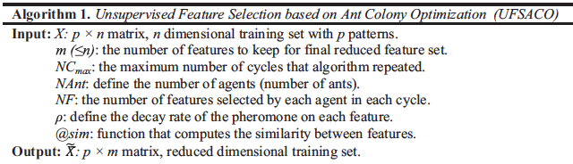
UFSACO – Algorithm (1)

Slide 44
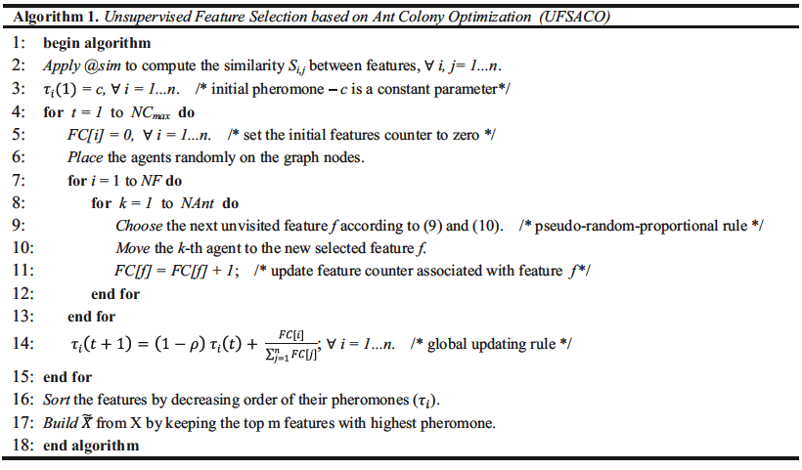
UFSACO – Algorithm (2)

Slide 45
Place your screenshot here
UFSACO – Demo project
https://gitlab.inf.unibz.it/aaronestrada/IntAgACOfeature
https://github.com/aaronestrada/IntAgACOfeature

Slide 46
UFSACO – Demo project Dataset
Reuters-21578 test collection for text categorization
 | Training | Test
Documents | 6489 | 2545
Features | 24087 | 15249
Class labels and number of documents in training and test datasets
Class | Training | Test | Class | Training | Test
earn | 2848 | 1083 | acq | 1636 | 712
wheat | 208 | 71 | grain | 83 | 38
money-fx | 369 | 130 | interest | 342 | 131
corn | 122 | 34 | crude | 389 | 189
trade | 350 | 108 | ship | 142 | 49

Slide 47
UFSACO – Demo project
UFSACO
Reuters-21578 training
dataset
UFSACO
Decision Trees
Performance using subsets
Information gain
Naïve Bayes
Gain ratio
Reduced training dataset after Feature Selection
Reuters-21578 test dataset

Slide 48
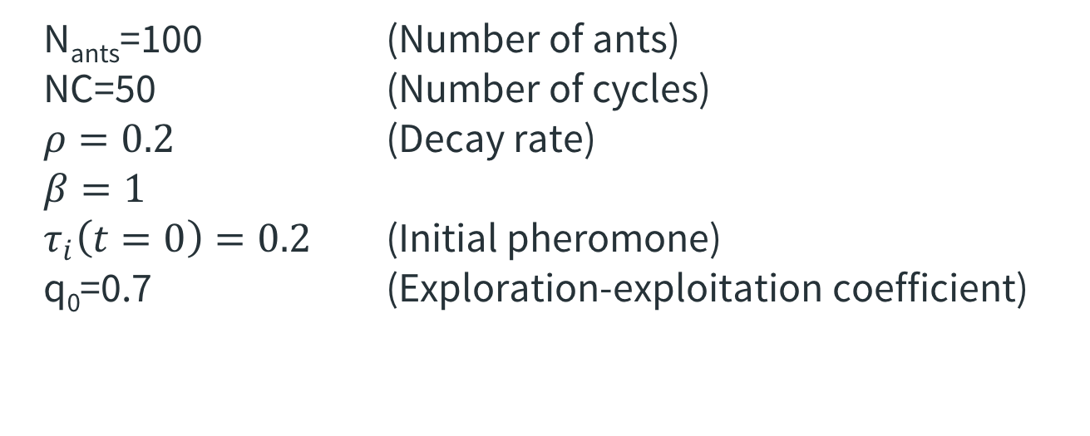
UFSACO – Demo project Evaluation - settings
N_{ants}=100 (Number of ants)
NC=50 (Number of cycles)
$ρ=0.2$ (Decay rate)
$$β=1$$
$τ_{i}\left(t=0\right)=0.2$ (Initial pheromone)
q₀=0.7 (Exploration-exploitation coefficient)

Slide 49
UFSACO – Demo project Evaluation – results
Classification results - % correct classification
Selected features | Classifier | UFSACO | Information gain | Gain ratio
5 | DT | 64,99 | 65,93 | 48,37
 | NB | 64,83 | 64,17 | 48,37
10 | DT | 69,93 | 69,12 | 72,38
 | NB | 69,43 | 66,64 | 72,77
20 | DT | 76,76 | 81,22 | 78,74
 | NB | 76,52 | 77,29 | 77,37
50 | DT | 84,85 | 85,74 | 79,41
 | NB | 85,35 | 82,71 | 77,33
75 | DT | 85,68 | 85,03 | 80,00
 | NB | 83,77 | 81,89 | 78,98

Slide 50
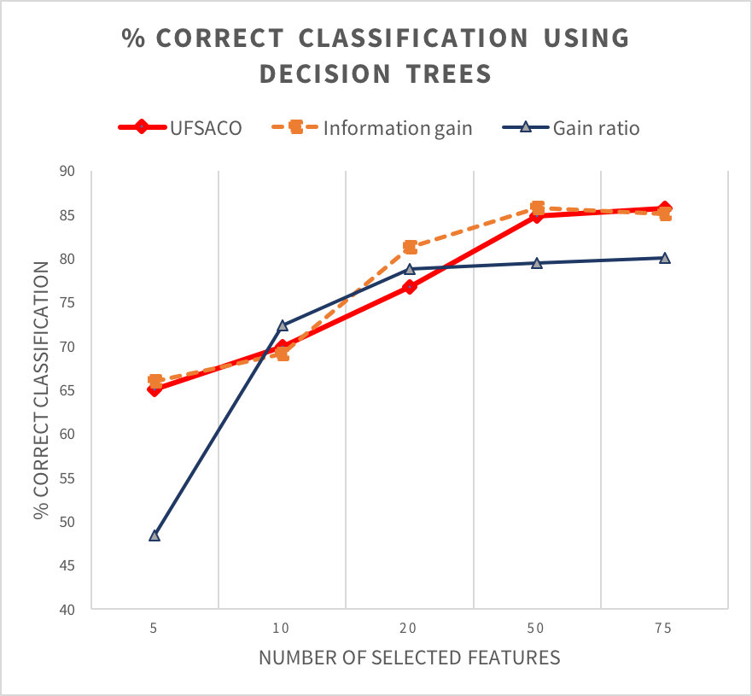
UFSACO – Demo project Evaluation – results

Slide 51
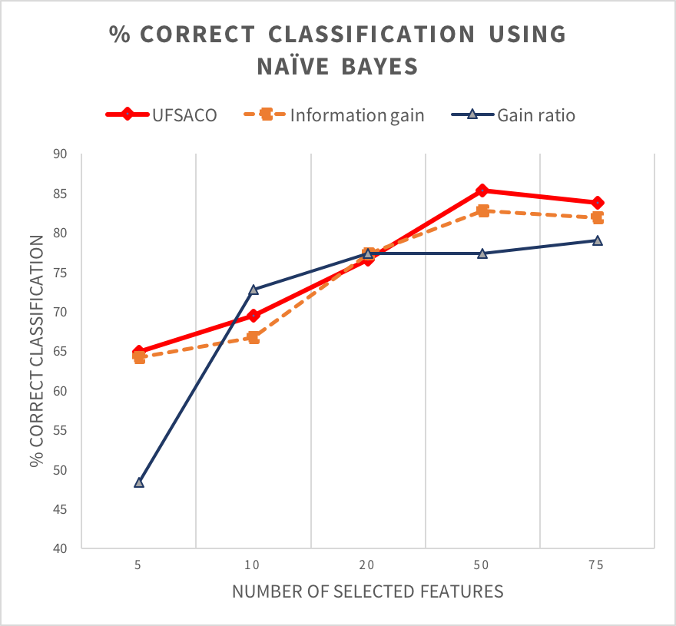
UFSACO – Demo project Evaluation – results

Slide 52
Thanks!
Any questions?
ruben.estrada@stud-inf.unibz.it
aaron.estrada.poggio@gmail.com

